Slide 1
Housing Sales Prices and Venues Data Analysis of Melbourne, Australia
Coursera Capstone Project

Slide 2
Finding affordable AND convenient housing in a new city is a nightmare for most
People of all kinds from across the globe flock to Melbourne, Australia for various reasons, with some of them aspiring to make this incredible place a home of their own
With varying budgets and needs, people find it very challenging to discover a suitable place with neighbourhood amenities of their choice
This project is aimed for people looking for acquiring new properties in Melbourne, but are sceptical due to lacking knowledge and volatile market conditions

Slide 3
Data acquisition and cleaning
For this data analysis project, the following data/dataset are used:
Melbourne Housing Dataset (Kaggle)
This data was scraped from publicly available results posted every week from Domain.com.au. The dataset has been cleaned, and now it available for us folks (data analysts) to do some data analysis magic
Foursquare API
To determine the various amenities in the proximity of a desired location, Foursquare location data is used.

Slide 4
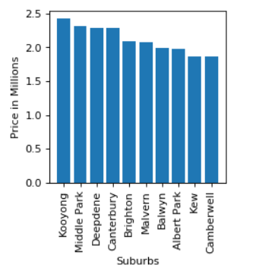
Analysing average housing prices for each suburb in Melbourne

Slide 5
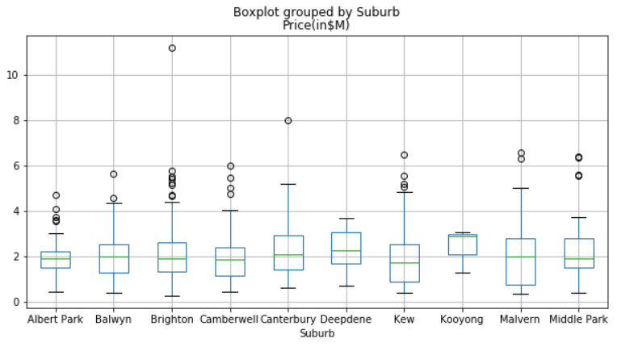
Analysing average housing prices for each suburb in Melbourne

Slide 6
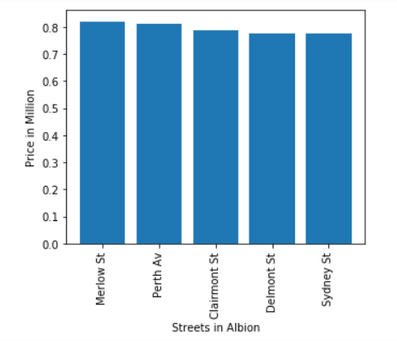
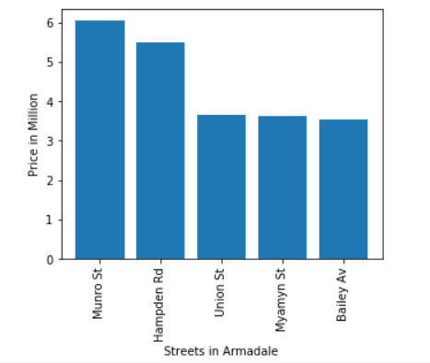
Analyzing average housing prices for each street in each suburb in Melbourne

Slide 7
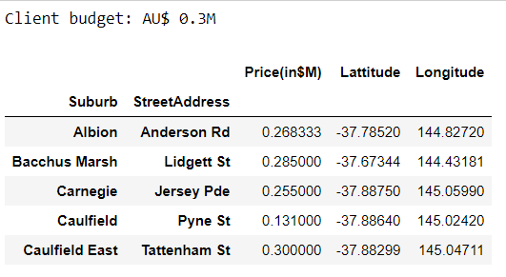
Recommending streets based on client budget (first phase)

Slide 8
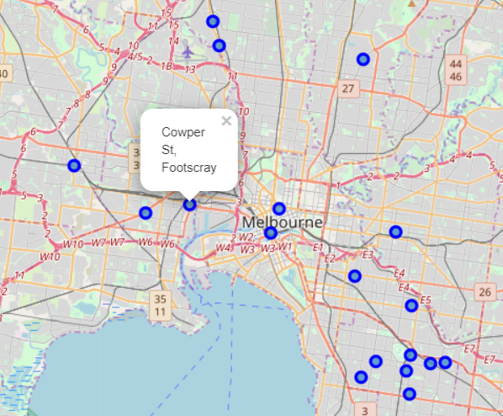
Plotting recommended locations/streets on the map of Melbourne with current housing market prices (first phase)

Slide 9
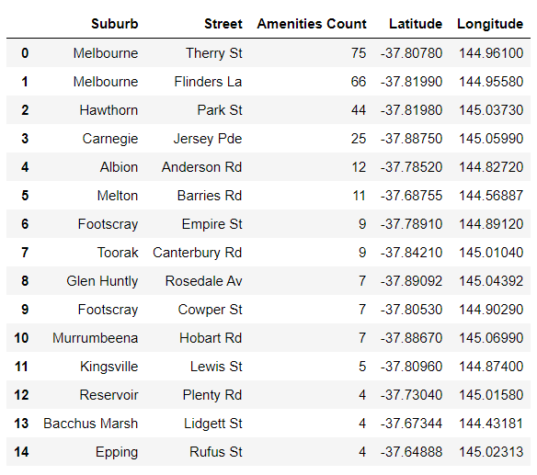
Recommending top 15 streets with the most total number of nearby amenities (second phase)

Slide 10
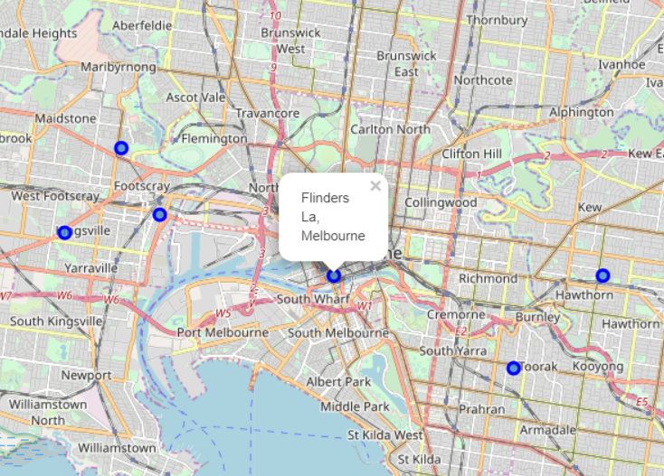
Plotting recommended locations on the map of Melbourne (second phase)

Slide 11
Conclusion and future directions
The decision of a buyer is influenced by the familial needs, personal biases and so on. So, based on the findings summarized in the results and discussion sections, following conclusions can be made:
While making recommendations to a prospective client, it is imperative to know his/her requirements besides the budget, which dictates his/her decision of buying the property largely. This would help to catch his/her attention
Knowledge about the most recent market prices can be very helpful for the client and can help him take an informed decision

